Slide 1

WEB DESIGN & DEVELOPMENT
Student Name : Nguyễn Nguyễn
ID : GCS18283

Slide 2
INTRODUCTION TO WWW
WWW is called global information lookup, It includes millions of websites, each built from multiple websites
Each website is built on an HTML (Hyper Text Transfer Protocol) language that has two basic characteristics:
1.Integrated audio image creating multimedia environment.
2.Creating allowed hyperlinks can jump from this site to another site without a sequence. To read web pages people use browsers (browsers). Current popular browsers are Internet Explorer (built into the operating system) and Nescape.

Slide 3
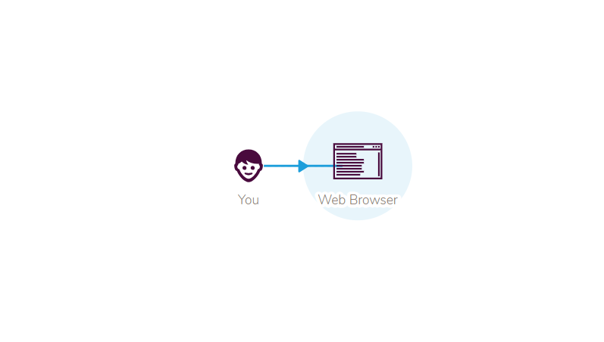
HOW DOES THE WEB WORK? (P1)
The site is viewed using one software program is called web browser

Slide 4
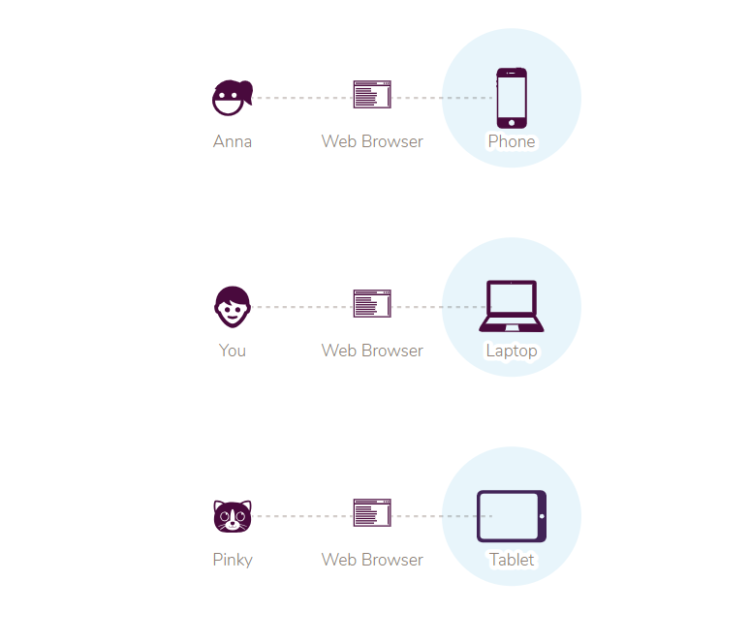
Web browsing software runs on laptop or electricity your smartphone is like Excel or Photoshop software.

Slide 5
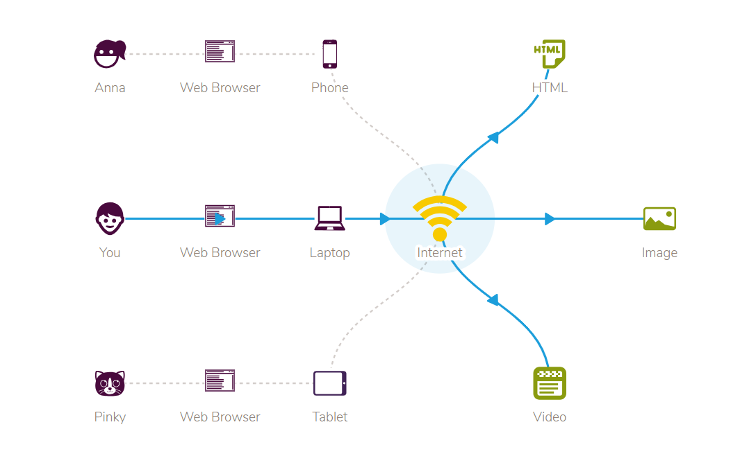
Web browser downloads content over the Internet.
The web browser can be downloaded and streamed online files like text, images, pdfs, movies and music.

Slide 6
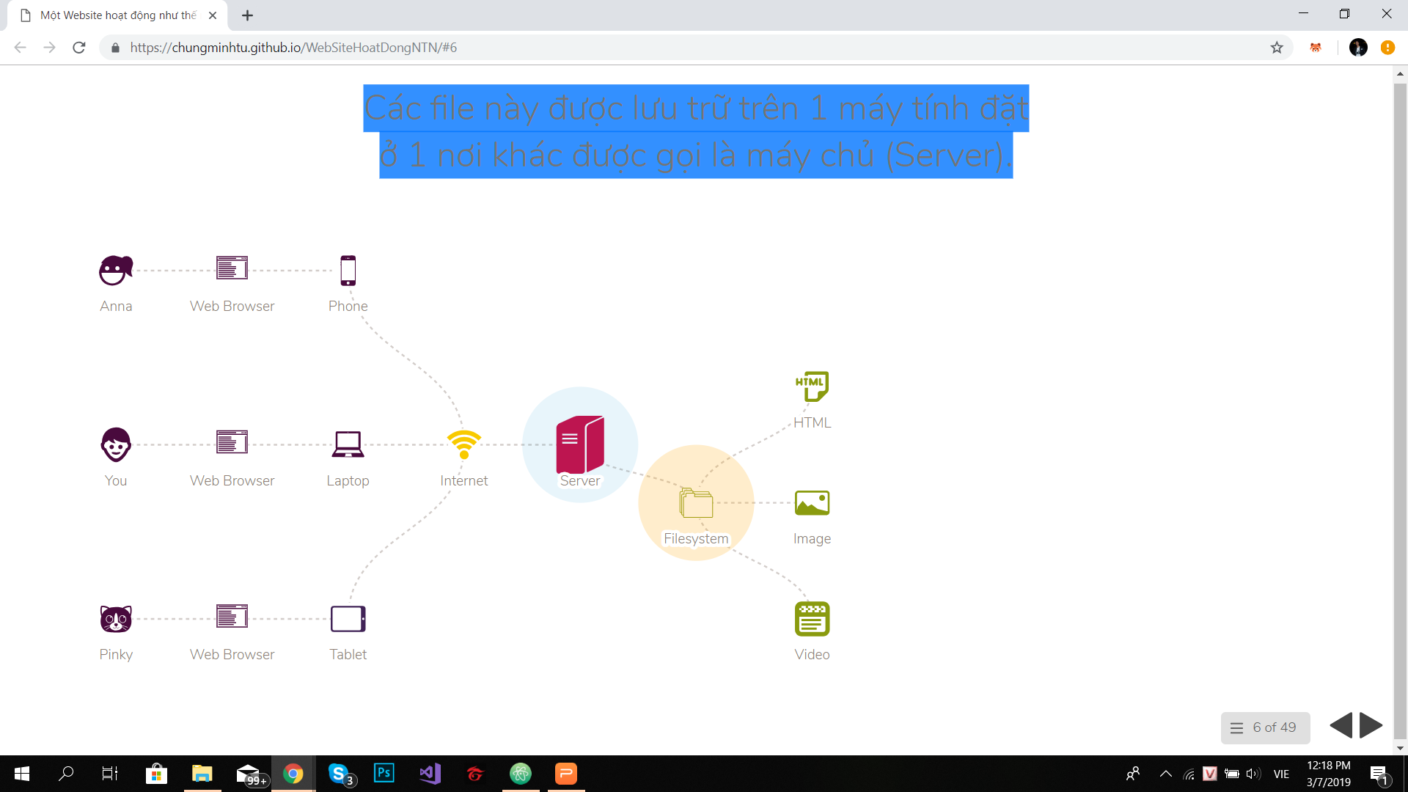
These files are stored on a computer in another place is called the server (Server).
The server is also a computer. It contains files in its system just like files and folders on your personal computer.

Slide 7
WHAT IS DOMAIN NAME SYSTEM (DNS) ? (P1)
DNS is officially defined in RFC1034 and RFC1035 standards, DNS makes the Internet more user-friendly.
Each network resource is represented by a numeric address (called an IP address), for example 123.123.123.123 is an IPv4 address type. And now with the introduction of all Internet devices (Internet of Things), the number of IPv4 addresses is exhausted and IPv6 has been launched to gradually replace IPv4.
Users only remember the website name but it is very difficult to remember the range of IP addresses of that website. Therefore, DNS is a service that allows users to enter the domain name on the web browser and the website name will be mapped to the network resource address where the website is hosted on the Internet.

Slide 8
DNS PURPOSE (WHY DO WE NEED DNS?) (P1)
Domain name system consists of a series of databases containing its IP address and corresponding domain names. Each domain name corresponds to a specific IP address.
The domain name system on the Internet is responsible for converting domain names to IP addresses and vice versa from IP addresses to domain names.
Domain names are more user-friendly than IP addresses, making it easier for users to remember because it is in text that ordinary people can understand and use every day, like home.vnn.vn or www.cnn.com. It can be said that the DNS system was born to provide easy-to-remember and suggestive domain names, making the Internet system easy to use for communication and growing.

Slide 9
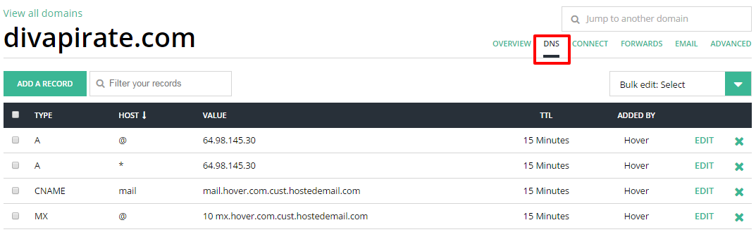
DNS TYPES (P1)
Types of DNS :
1. A
Bản ghi A xác định địa chỉ IPv4 hoặc IPv6 của tài nguyên mạng.

Slide 10
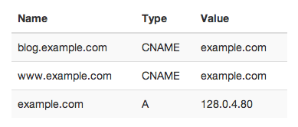
2. CNAME
The CNAME (canonical name) record that identifies another identifier or "alias" will be resolved until A records are found.

Slide 11
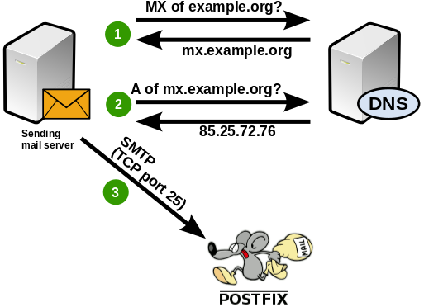
3. MX
MX record (mail exchange) identifies the resource name and mail server list in order of priority for that domain name.

Slide 12
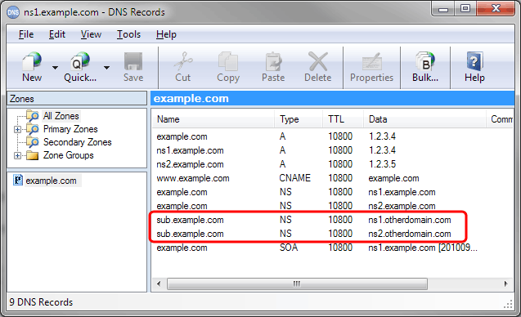
4. NS
NS record (name server) determines the authoritative name server of the domain.

Slide 13
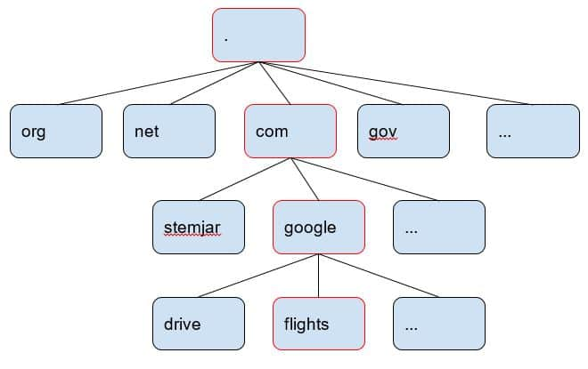
HOW DO DOMAIN NAME WORK? (P1)
A domain name is divided into several levels:
1. GTLD (Generic Top Level Domain) - domain names end in .com, .net, .org, .gov, .edu and .name.

Slide 14
2. CCTLD (Country Code Top Level Domain) - separate domain name for each country (eg .il, .ru, .uk,, us, .cn, .vn).

Slide 15
3. Infrastructure TLD - Handling and navigating switching from IP address to domain, IPv4 example 48.199.81.in-addr.arpa. Used in the PTR record (explained below).

Slide 16
COMMUNICATION PROTOCOL (P2)
The communication protocol, also known as communication protocol, inter-network protocol, interactive protocol, information exchange protocol (English communication communication) - in the information technology is referred to as protocol. , however, to avoid confusion with protocols in other industries - is a set of standard rules for data representation, signaling, authentication and data error detection - necessary to send information believe through communication channels, whereby computers (and devices) can connect and exchange information with each other

Slide 17
There are many protocols used to communicate or communicate information on the Internet, here are some typical protocols:
1.TCP (Transmission Control Protocol): establish a connection between computers to transfer data. It splits data into packets and ensures successful data transmission.
2.IP (Internet Protocol): routing packets when they are transmitted over the Internet, ensuring data will arrive at the right place.
3.HTTP (HyperText Transfer Protocol): allows the exchange of information (mostly in hypertext form) over the Internet.
4.FTP (File Transfer Protocol): allows file exchange over the Internet.
5.SMTP (Simple Mail Transfer Protocol): allows sending email messages (e-mail) over the Internet.
6.POP3 (Post Office Protocol, version 3): allows receiving email messages via the Internet.
7.MIME (Multipurpose Internet Mail Extension): an extension of the SMTP protocol, allowing the attachment of binary files, movies, music, ... by email.
8.WAP (Wireless Application Protocol): allows the exchange of information between wireless devices, such as mobile phones.

Slide 18
SERVER HARDWARE (P2)
Server or server is a system (software and computer hardware that meets the requirements) on a computer network to provide or support the provision of a network service. Servers can run on a dedicated computer, which is also commonly referred to as a "server", or multiple networked computers capable of hosting servers. In many cases, a computer can provide a wide variety of services and services.

Slide 19
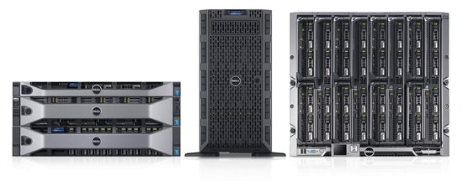
Cơ sở để phân loại các loại máy chủ là dựa theo phương pháp chế tạo ra máy chủ, ta có 3 loại máy chủ thường gặp sau:
1. Dedicated
2. Virtual Private Server – VPS
3. Cloud Server

Slide 20
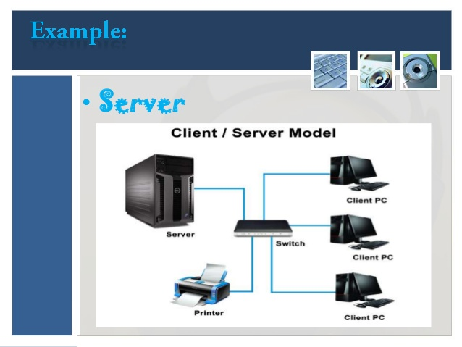
SERVER OPERATING SYSTEM (P2)
A server operating system, also called a server OS, is an operating system specifically designed to run on servers, which are specialized computers that operate within a client/server architecture to serve the requests of client computers on the network.

Slide 21
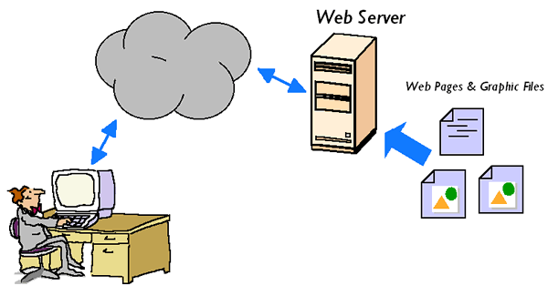
WEB SERVER (P2)
Web server is a large computer connected to an extended set of computer networks. This is a type of server on the internet each server is a different IP and can read languages ​​such as * .htm files and * .html ... In short, the server is a repository to store all data operating on the internet. It is given authority to manage.

Slide 22
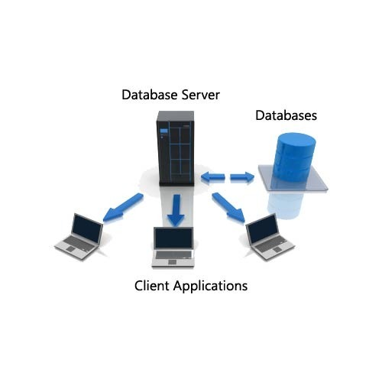
DATABASE SERVER (P2)
Database Server is the server that is installed with the software of database management system such as SQL server, mySQL, Oracle ...

Slide 23
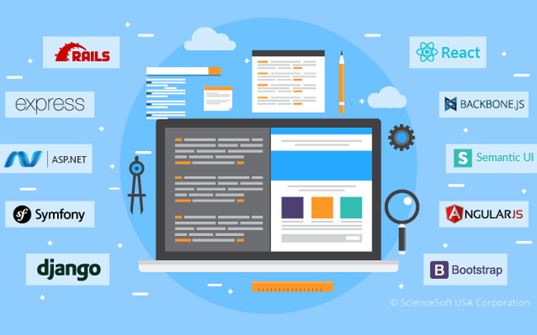
WEB APPLICATION (P3)
Web applications are computer programs that use web browsers and web technologies to perform tasks over the Internet.

Slide 24
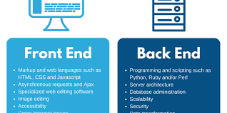
RELATIONSHIP BETWEEN FRONT-END AND BACK-END TECHNOLOGIES (P3)
Front-end and back-end are terms indicating the start and end stages of a process. This concept is often used in the field of software development.
In software design, the front-end is part of the software system, which directly interacts with users. Specifically, it is the system of user interfaces (GUI) and user-side programming.
The back-end (the programming part on the server) includes components to handle information from the Front-end. Usually refers to interaction with DBMS (data management system).

Slide 25
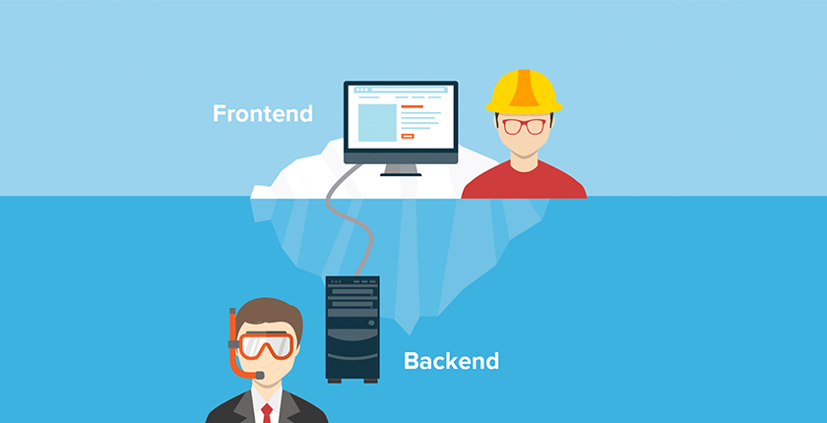
DIFFERENCE BETWEEN FRONT-END & BACK-END DEVELOPMENT (P3)
The front-end part of a website is the part that interacts with the user. Everything you see when navigating on the Internet, from fonts, colors to drop-down menus and sliders, is a combination of HTML, CSS, and JavaScript controlled by the browser. your calculator.

Slide 26
The back end of a web page includes a server, an application, and a database. A back-end programmer builds and maintains technology that powers those components, allowing the user interface of the site to exist.
Skills and tools

Slide 27
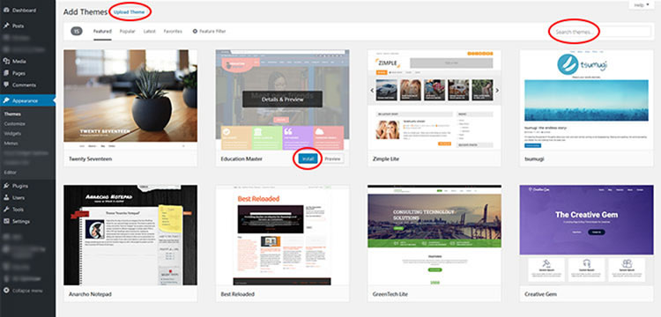
DIFFERENCES BETWEEN ONLINE WEBSITE CREATION TOOL & CUSTOM BUILT SITES (P4)
The online web creation tool is easier, faster, but it does have the things we want but can't. And the built-in custom tool makes it easy to do what you want, but it will be harder and longer

Slide 28
REFERENCES
https://web.stanford.edu/class/msande91si/www-spr04/readings/week1/InternetWhitepaper.htm
https://www.primedesignsolutions.com/learning-center/difference-template-custom-built-websites/
https://conceptainc.com/blog/difference-front-end-back-end-development/
https://www.webopedia.com/TERM/S/server_operating_system.html
https://searchdatacenter.techtarget.com/feature/Learn-the-major-types-of-server-hardware-and-their-pros-and-cons

